Slide 1
UCEN OFFICE AUTOMATION SYSTEM USING CLOUD COMPUTING
TEAM MEMBERS
AAKIF MUHSIN J (962819205001),
ASWIN RAJA A (962819205004),
VIBUNESH A (962819205039)
GUIDED BY
,Dr. J. BANUMATHI, M.E., Ph.D
AAKIF MUHSIN J
ASWIN RAJA A
VIBUNESH A

Slide 2
OVERVIEW
OBJECTIVE
SCOPE
EXISTING SYSTEM
LIMITATIONS OF EXISTING SYSTEM
PROPOSED SYSTEM
INTRODUCTION
SYSTEM ARCHITECTURE
MODULES & DESCRIPTION
RESULT & DISCUSSION
CONCLUSION

Slide 3
OBJECTIVE
1.To reduce the time spent on manual work and human error in managing data at college office.
2.To improve the process of student data handling .
3.Enhance the students to view their academic profile.

Slide 4
SCOPE
1.It helps the admin to manage and control the entire data of the students in our institution.
2.It also helps the faculty to get the complete academic profile of a particular student.
3.It helps to manage the scholarship data of the students effectively.

Slide 5
EXISTING SYSTEM
1.The activities such as student data filtration base on the eligibility for different scholarship schemes and student profile management are done manually or stored in the excel files.
2.The Faculty has to approach student or excel files to find the complete profile about any student.
3.The Stock Management is done by maintaining record of stocks in the stock maintenance record book.
4.The Office Admin has to type bonafide for each and every student in word file.

Slide 6
LIMITATIONS OF EXISTING SYSTEM
Time-consuming and prone to human errors during data entry and filtration.
Inefficient and time-consuming process to retrieve complete student profiles.
Difficulty in tracking and analyzing student data for decision-making purposes.
Lack of real-time visibility, making it challenging to manage stock effectively.
Typing bonafide documents manually is a time-consuming and repetitive task for the office admin

Slide 7
PROPOSED SYSTEM
The proposed system would be web-based and have a user-friendly interface for easy navigation.
The Scholarship Management module would filter data based on caste and department to generate scholarship reports.
The Stock Management module would filter data based on stock incoming and outgoing details and location changes to generate stock reports.
The Student Profile Management module would retrieve all student data and display arrear details, basic profile details, and other relevant information for a specific candidate.
The Bonafide Generation module would generate Bonafide certificates based on the Register number and reason provided.

Slide 8
INTRODUCTION
The "UCEN Office Automation System" is an advanced software solution developed to address the challenges faced by college offices in managing student data using traditional methods. This comprehensive system encompasses modules such as Scholarship Management, Stock Management, Student Profile Management, and Bonafide Generation. By automating these key operations, the system aims to reduce manual workload and minimize human errors. With its cloud-based technology, the system offers remote accessibility for administrators and students.

Slide 9
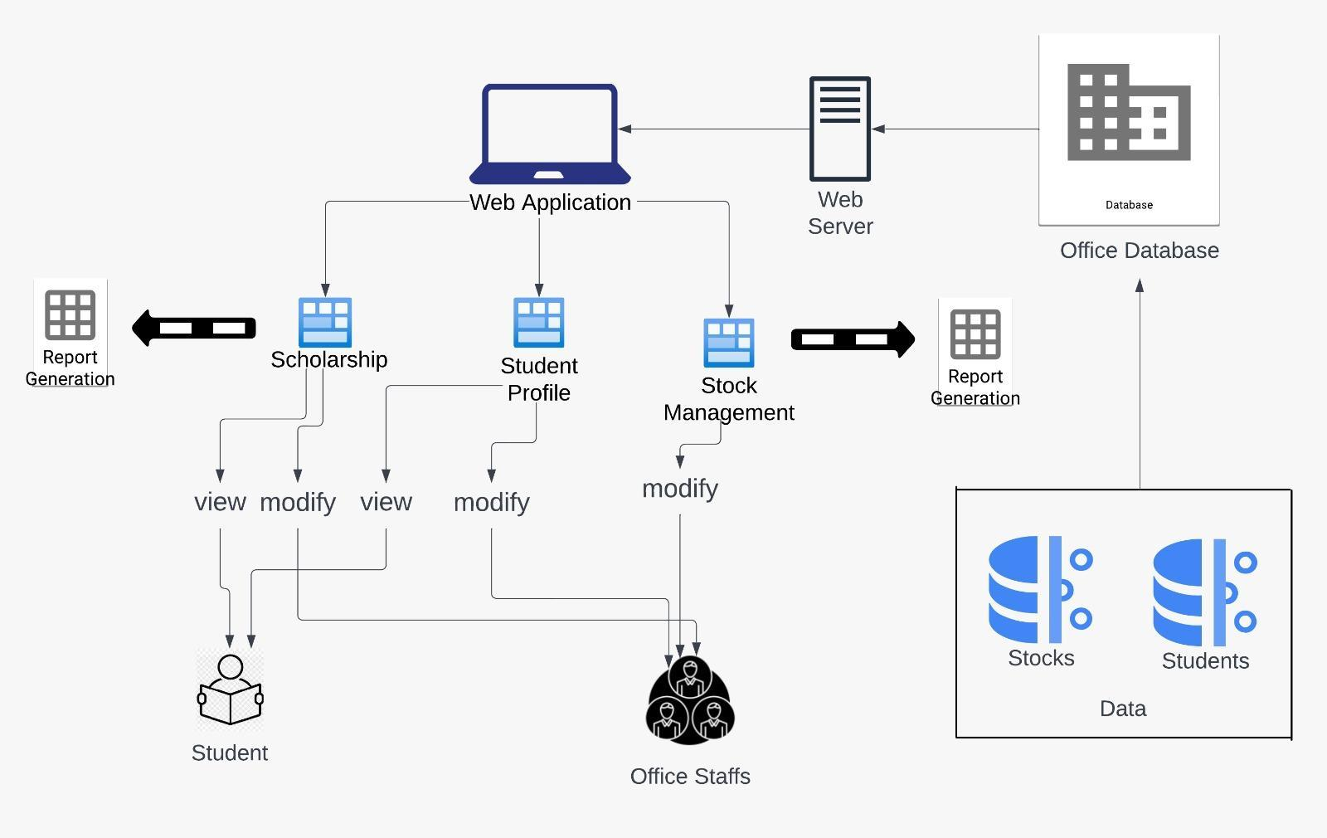
SYSTEM ARCHITECTURE

Slide 10
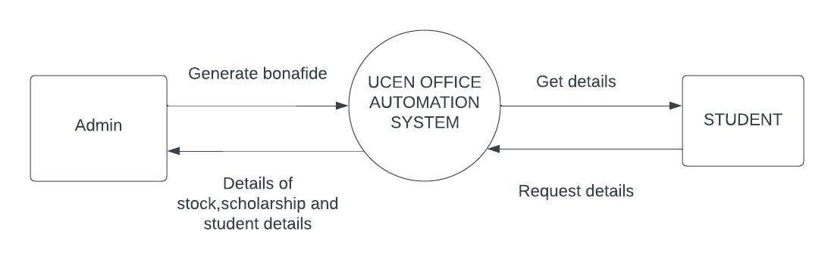
DFD - LEVEL 0

Slide 11
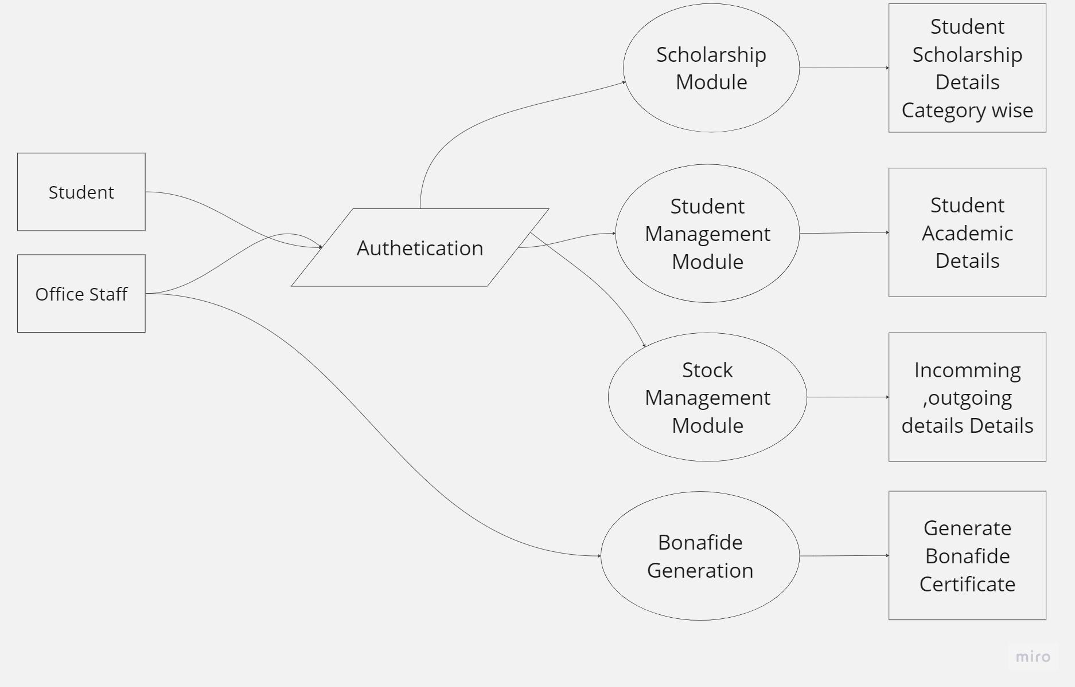
DFD - LEVEL 1

Slide 12
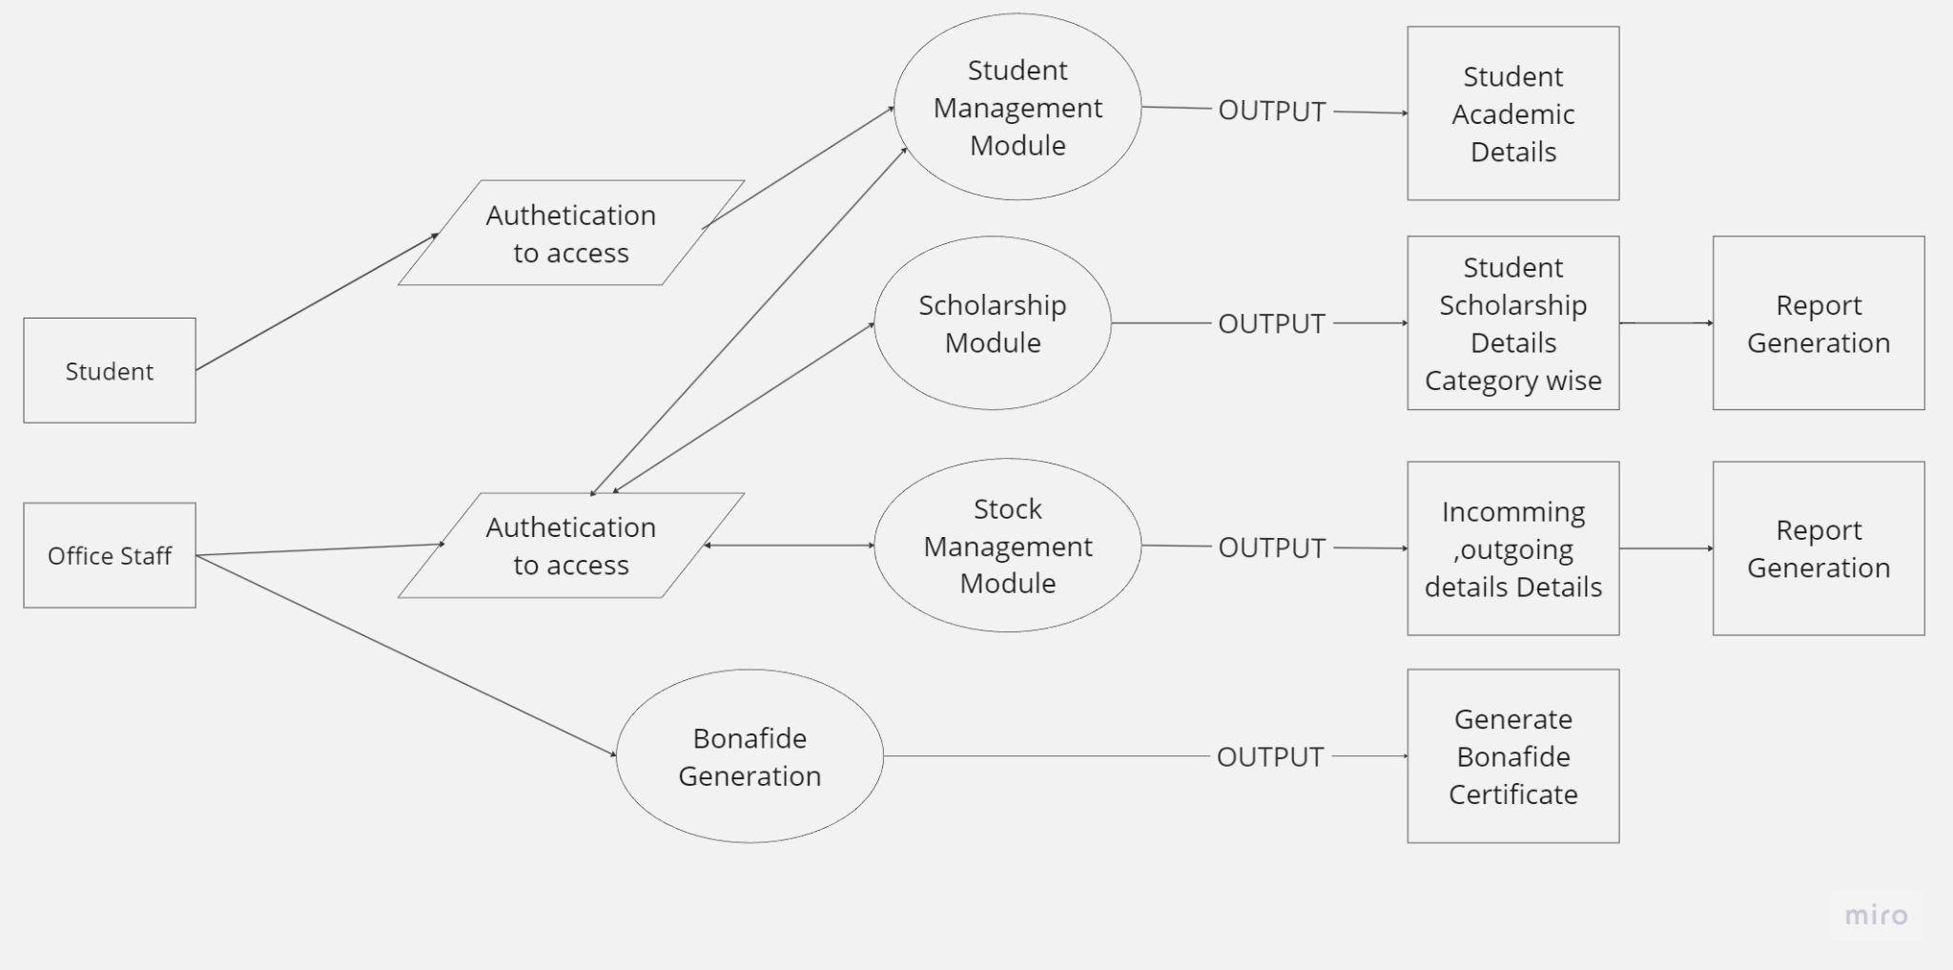
DFD - LEVEL 2

Slide 13
MODULES
BONAFIDE GENERATION
SCHOLARSHIP MANAGEMENT
STOCK MANAGEMENT
STUDENT PROFILE MANAGEMENT

Slide 14
BONAFIDE GENERATION
A powerful software component that automates the process of generating Bonafide certificates.
By simply entering the student's Register number and reason, the module retrieves the necessary information from the database and generates a professionally formatted certificate.
This eliminates the need for manual typing, saving time and reducing errors. With standardized templates and accurate data, the module ensures consistency and streamlines the administrative workflow, providing efficient and reliable Bonafide certificate generation.

Slide 15
SCHOLARSHIP MANAGEMENT
Data filtering tool that allows for the generation of scholarship reports based on caste and department criteria.
Efficiently filters and organizes the data to provide comprehensive reports on scholarships.
By specifying the desired caste and department parameters, the module extracts and presents the relevant information, enabling quick and accurate analysis of scholarship distribution.
Eliminates the need for manual data sorting and greatly enhances the efficiency and effectiveness of scholarship management.

Slide 16
STOCK MANAGEMENT
Filters data based on stock incoming and outgoing details as well as location changes to generate comprehensive stock reports.
Users can specify the desired parameters such as stock incoming, outgoing transactions, and location changes to retrieve specific stock-related information.
Efficiently filters and organizes the data, enabling the generation of detailed reports on stock movements, current stock levels, and stock location changes.
Simplifies stock management, improves inventory control, and provides valuable insights for effective decision-making.

Slide 17
STUDENT PROFILE MANAGEMENT
Versatile tool that retrieves and displays comprehensive student data, including arrear details, basic profile information, and other relevant data for a specific candidate.
Allows users to access and view all the necessary information related to a student's profile in a centralized and organized manner.
By inputting the candidate's details or unique identifier, the module fetches and presents their arrear status, basic profile details such as name, contact information, academic history, and any other relevant information

Slide 18
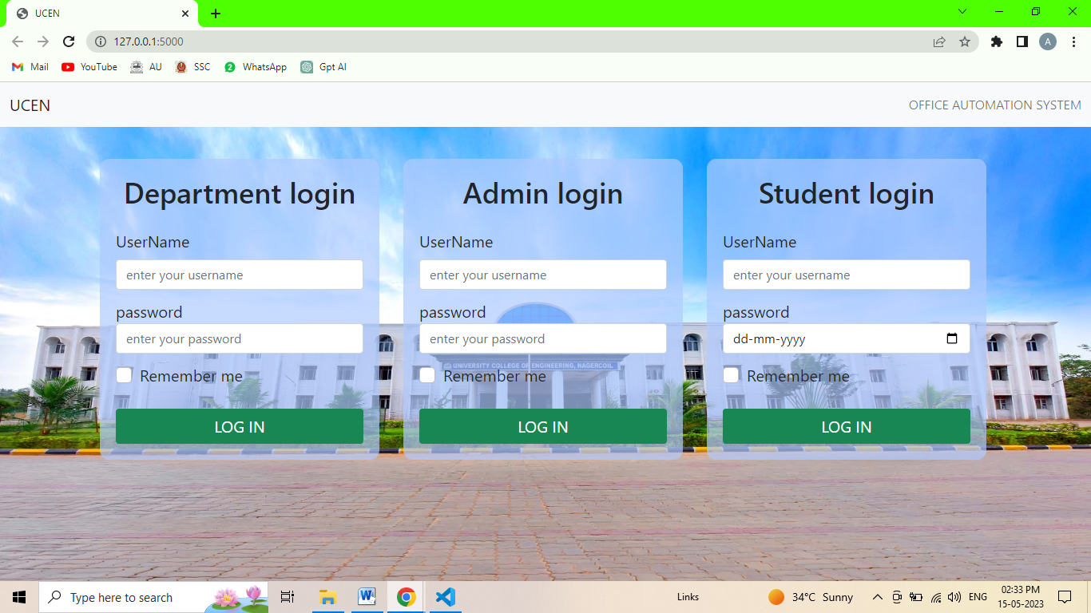
RESULT AND DISCUSSION
Home Page

Slide 19
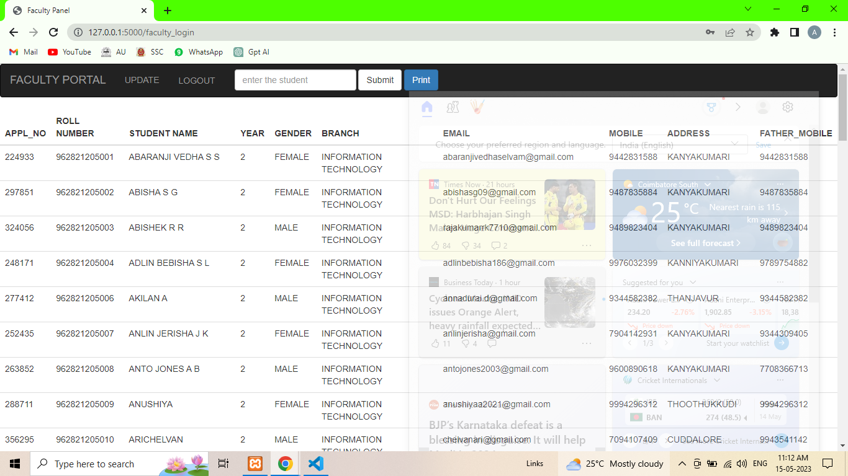
RESULT AND DISCUSSION
Department Login

Slide 20
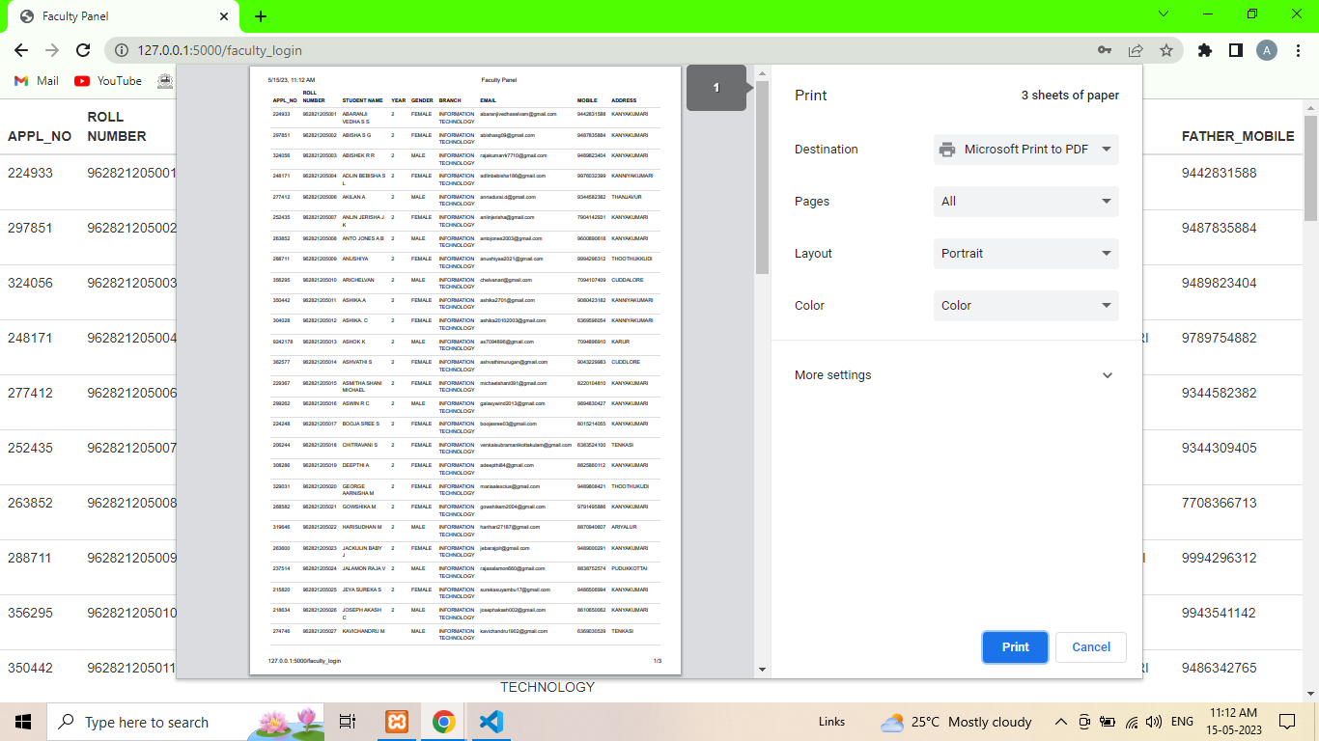
RESULT AND DISCUSSION
Report Generation

Slide 21
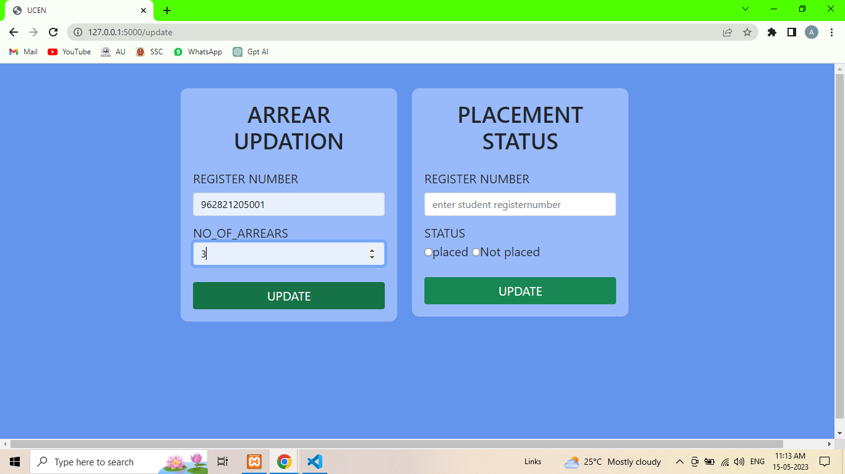
RESULT AND DISCUSSION
Arrear & Placement Updation

Slide 22
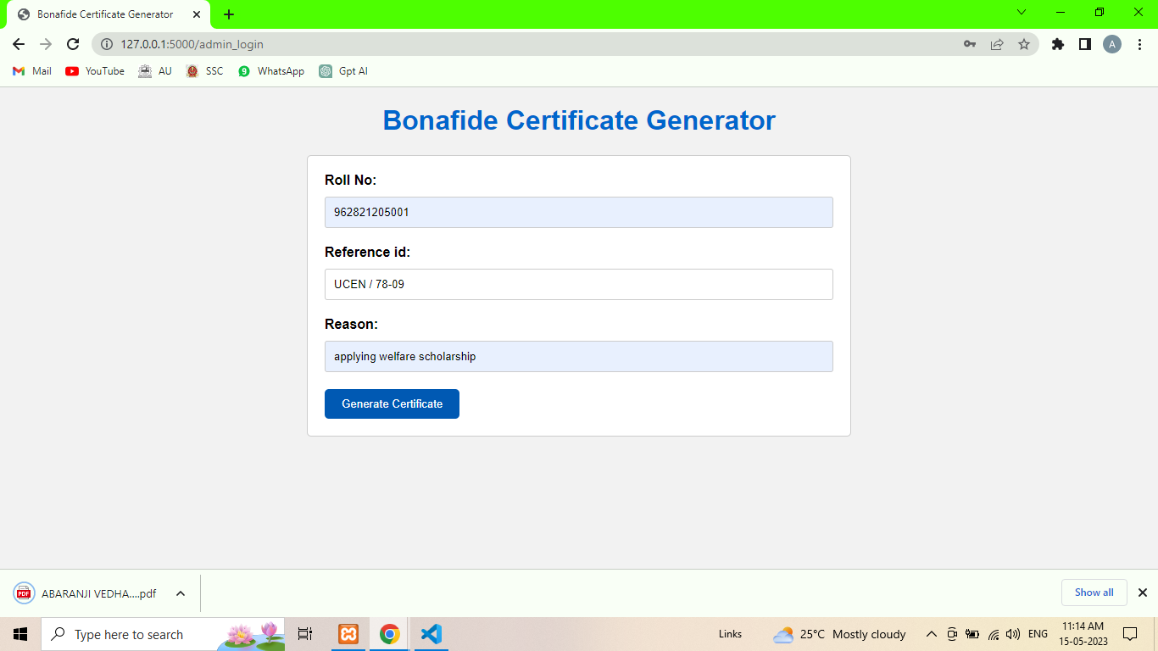
RESULT AND DISCUSSION
Bonafide Generation

Slide 23
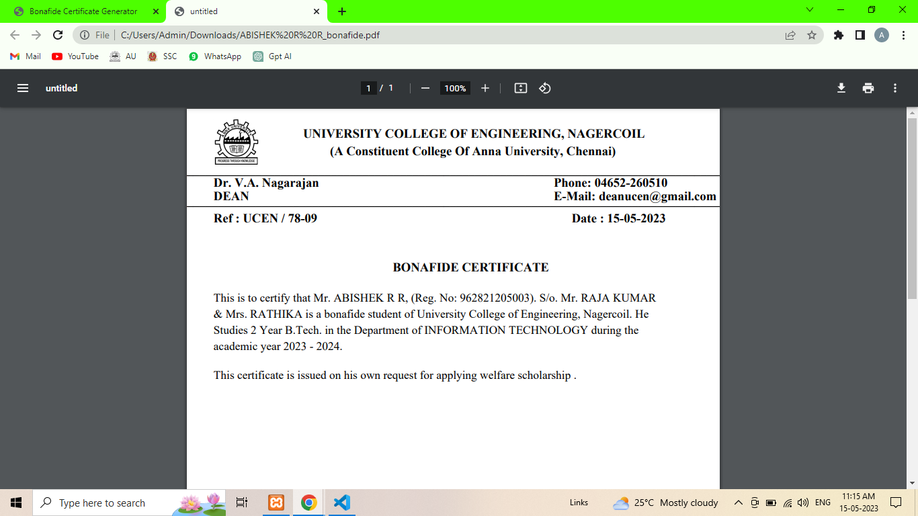
RESULT AND DISCUSSION
Generated Bonafide

Slide 24
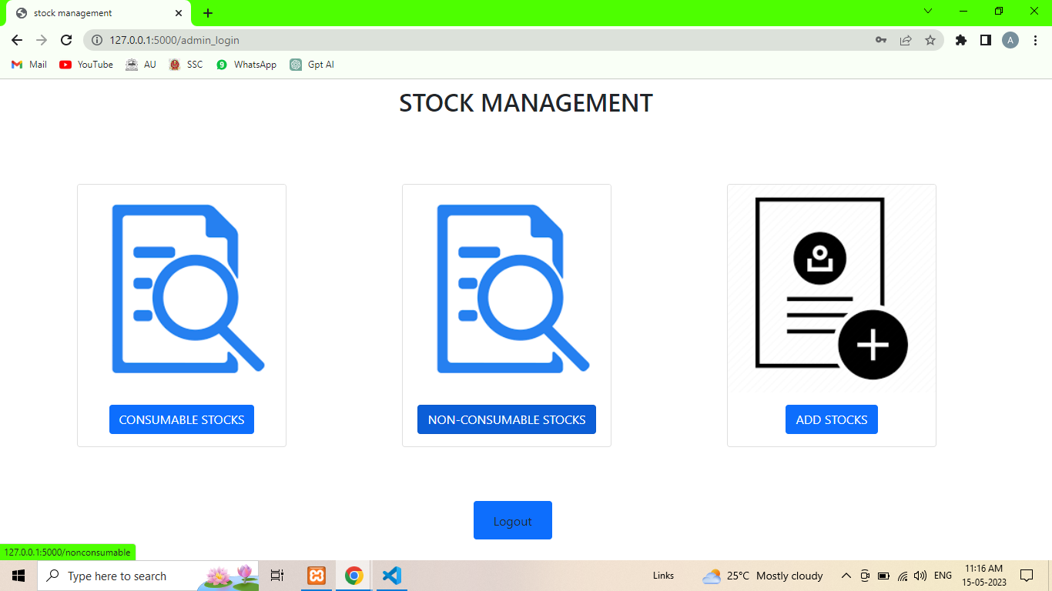
RESULT AND DISCUSSION
Stock Admin Panel

Slide 25
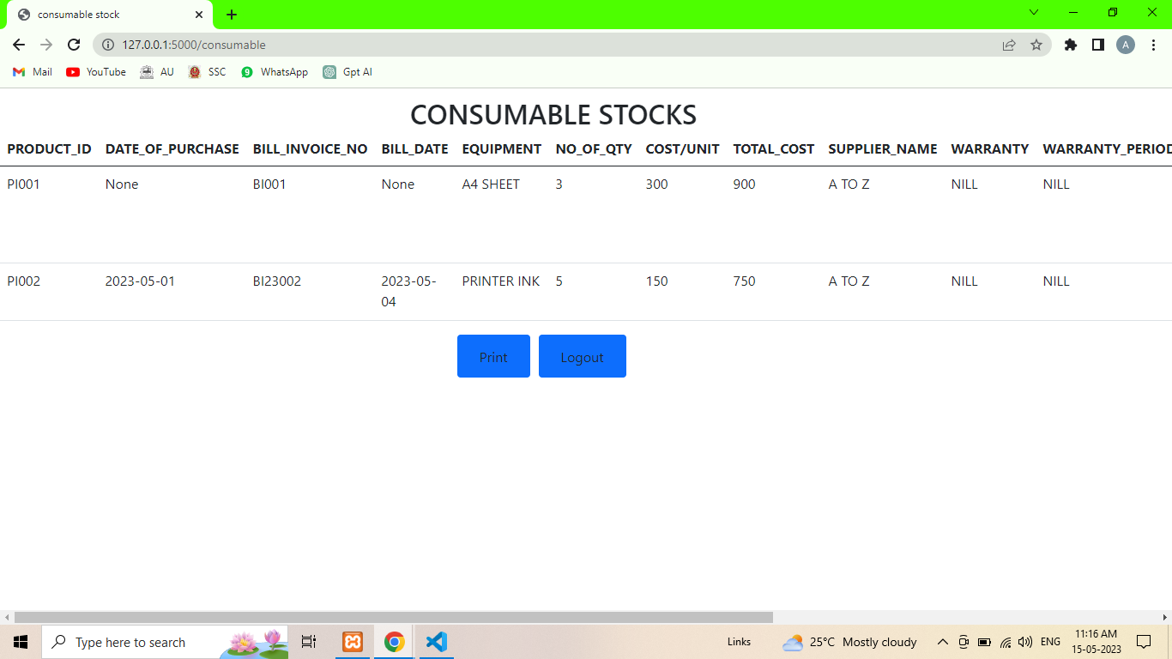
RESULT AND DISCUSSION
Stock View

Slide 26
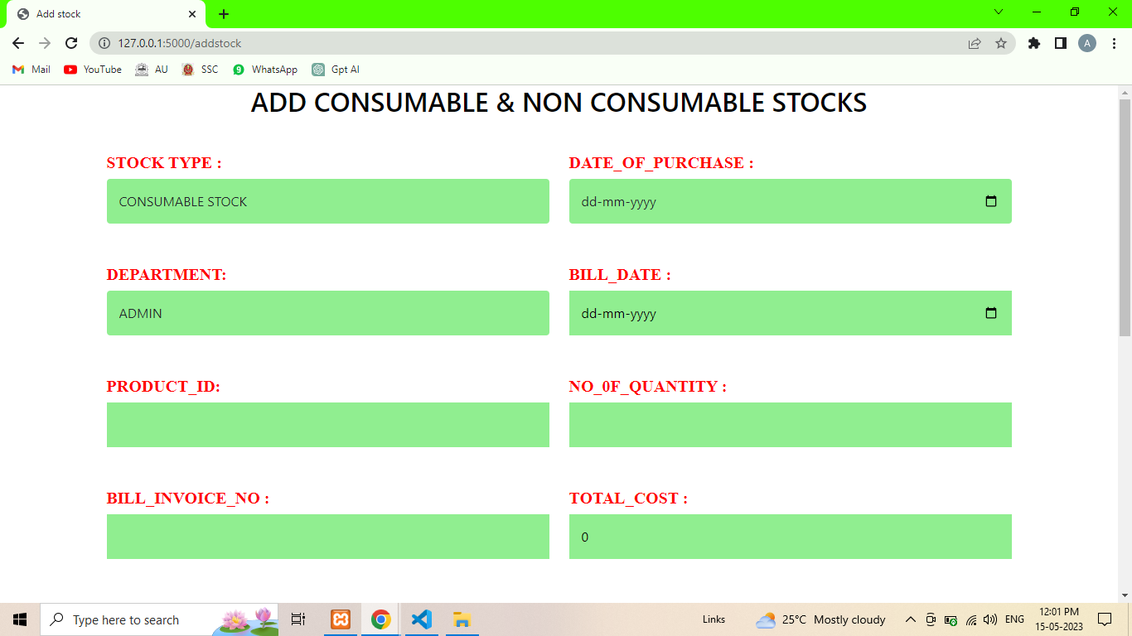
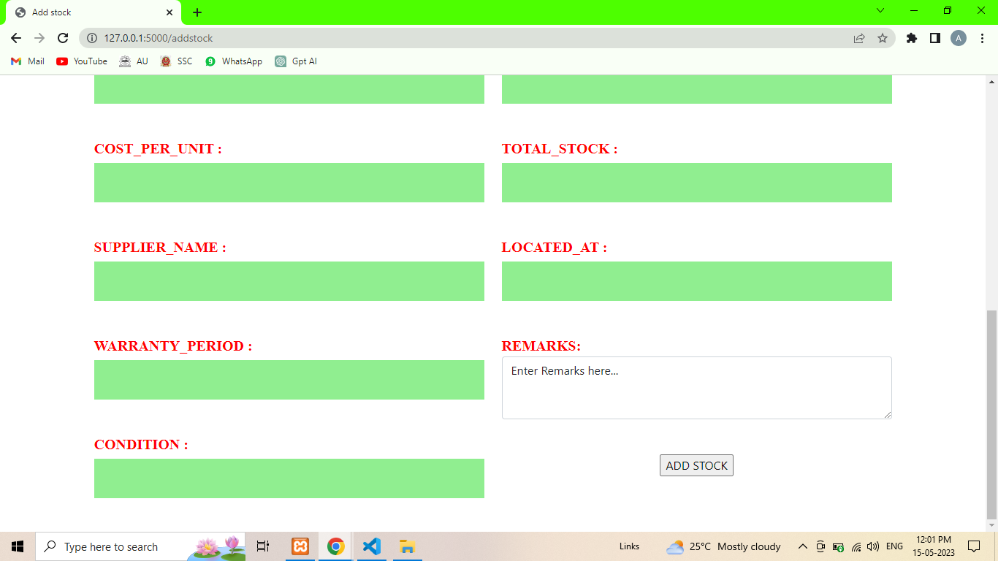
RESULT AND DISCUSSION
Add Stock

Slide 27
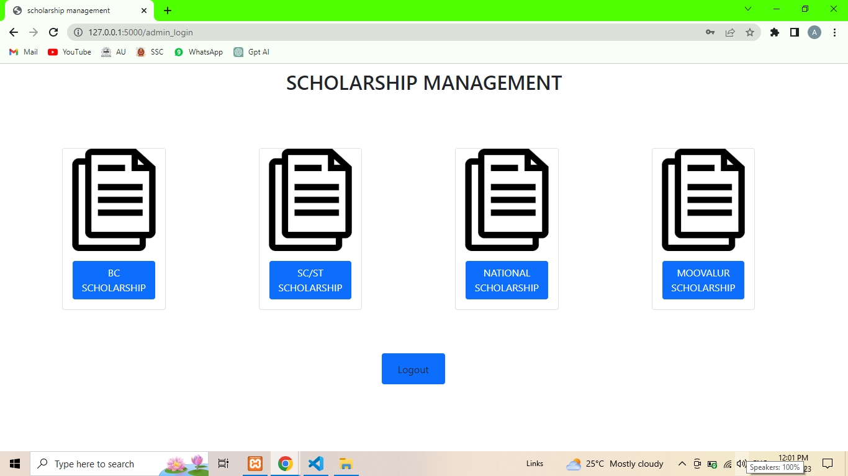
RESULT AND DISCUSSION
Scholarship Admin Panel

Slide 28
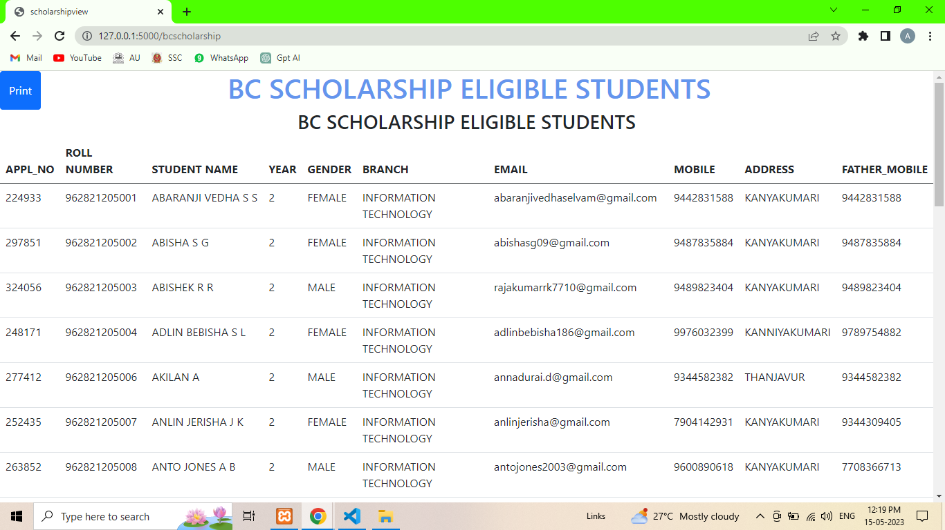
RESULT AND DISCUSSION
Student Profiles Filtered based on Scholarship Eligibility

Slide 29
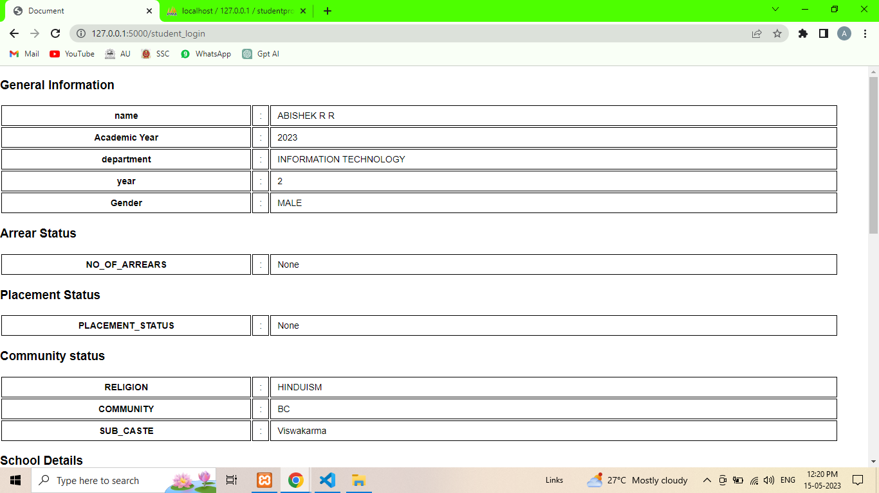
RESULT AND DISCUSSION
Student Profile View

Slide 30
CONCLUSION
In conclusion, the UCEN Office Automation System offers a comprehensive solution to the challenges faced by college offices in managing student data manually. By streamlining Scholarship Management, Stock Management, Student Profile Management, and Bonafide certificate generation, the system enables significant time savings and reduces the likelihood of errors. Implementing this system enhances administrative efficiency and provides a more efficient and reliable approach to managing student information, ultimately benefiting the college office and improving overall productivity.

Slide 31
Thank you

